Slide 1
BONES DISEASE CONDITIONS Dr. R.S.G.SOWMYA, Assistant Professor Dept of Pathology, SKHMC, kulasekharam

Slide 2
RHEUMATOID ARTHRITIS

Slide 3
Rheumatoid Arthritis is a chronic systemic autoimmune disorder causing a symmetrical polyarthritis.
Epidemiology
–RA affects 0.5–1% of the population world-wide with a peak prevalence between the ages of 30 and 50 years.

Slide 4
Aetiology and pathogenesis
Gender- Women before the menopause are affected three times more often than men with an equal sex incidence thereafter suggesting an aetiological role for sex hormones.
Familial -There is an increased incidence in those with a family history of RA.

Slide 5
Genetic factors –
Human leucocyte antigen (HLA)-DR4 and HLA-DRB1* 0404/0401 confer susceptibility to RA

Slide 6
Pathology
RA is characterized by synovitis with thickening of the synovial lining and infiltration by inflammatory cells.
Generation of new synovial blood vessels is induced by angiogenic cytokines
Activated endothelial cells produce adhesion molecules
vascular cell adhesion molecule-1 (VCAM-1)
Which expedite extravasation of leucocytes into the synovium.

Slide 7
The synovium proliferates and grows out over the surface of cartilage, producing a tumour- like mass called ‘pannus’
Pannus destroys the articular cartilage and subchondral bone, producing bony erosions

Slide 8
Clinical features
Onset of pain
Early-morning stiffness (lasting more than 30 minutes)
Swelling in the small joints of the hands and feet
As the disease progresses there is weakening of joint capsules
joint instability
Subluxation
deformity

Slide 10
Non-articular manifestations of RA
Systemic – Fever, Fatigue, Weight loss
Eyes- Scleritis, Scleromalacia perforans (perforation of the eye)
Neurological- Carpal tunnel syndrome, Atlanto- axial subluxation, Cord compression

Slide 11
Haematological
Lymphadenopathy, Felty’s syndrome (rheumatoid arthritis, splenomegaly, neutropenia), Anaemia (chronic disease, NSAID- induced, gastrointestinal blood loss, haemolysis, hypersplenism), Thrombocytosis

Slide 12
Pulmonary - Pleural effusion, Lung fibrosis, Rheumatoid nodules, Rheumatoid pneumoconiosis
Heart and peripheral vessels – Pericarditis, Pericardial effusion, Raynaud’s syndrome
Vasculitis - Leg ulcers, Nail fold infarcts, Gangrene of fingers and toes
Kidneys - Amyloidosis causes the nephrotic syndrome and renal failure

Slide 13
Investigations
Blood count- usually a normochromic, normocytic anaemia, ESR and CRP are raised
Serum autoantibodies - Anti-CCP has high specificity (90%) and, Rheumatoid factor is positive in 70% of cases sensitivity (80%) for RA.
X-ray- joint narrowing, erosions at the joint margins
Synovial fluid - high neutrophil count in uncomplicated disease

Slide 14
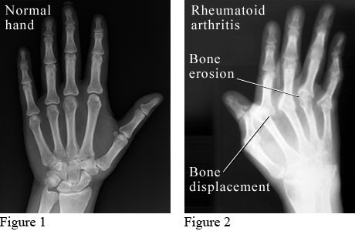
RADIOLOGY

Slide 16
Criteria for Diagnosing RA
For 6 weeks or more
Morning stiffness > 1 hour
Arthritis of three or more joints
Arthritis of hand joints and wrists
Symmetrical arthritis
Subcutaneous nodules
A positive serum rheumatoid factor
Typical radiological changes (erosions and/or periarticular osteopenia)

Slide 17
Complications of RA
Ruptured tendons
Ruptured joints (Baker's cysts)
Joint infection
Spinal cord compression (atlantoaxial or upper cervical spine)
Amyloidosis (rare)
Side-effects of therapy

Slide 18
OSTEOMYELITIS

Slide 19
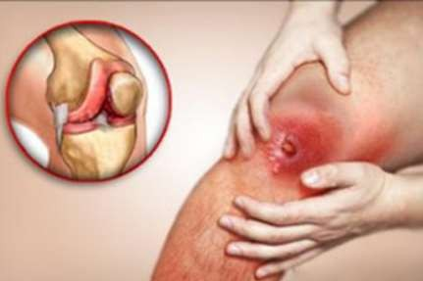
Osteomyelitis is a severe infection of the bone, bone marrow and surrounding soft tissue

Slide 20
AETIOLOGY
Staphylococcus aureus causes 70% to 80% of bone infections.
Proteus , Pseudomonas species and
Escherichia coli

Slide 21
PATHOPHYSIOLOGY
Entry of microorganism by
Direct
Indirect

Slide 22
INDIRECT
Extension of soft tissue infection (eg, infected pressure or vascular ulcer, incisional infection)
Hematogenous (bloodborne) spread from other sites of infection (eg, infected tonsils, infected teeth, upper respiratory infections)

Slide 23
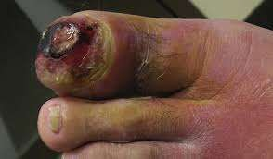

Slide 24
Direct bone contamination from bone surgery, open fracture, prosthesis or traumatic injury (eg, RTA )

Slide 25
Factors affect the extent of infection
Virulence of the infecting organism,
Underlying disease
Immune status of the host,
The type, location, and vascularity of the bone

Slide 26
inflammation, increased vascularity, and edema
After 2 or 3 days, thrombosis of the blood vessels occurs in the area, resulting in ischemia with bone necrosis
The infection extends into the medullary cavity and under the periosteum ,cortex and marrow cavity and may spread into adjacent soft tissues and joints

Slide 27
Unless the infective process is treated promptly, a bone abscess forms. The resulting abscess cavity contains dead bone tissue (the sequestrum), which does not easily liquefy and drain
New bone growth (the involucrum) forms and surrounds the sequestrum.

Slide 30
When bone infection persists for months, the resulting infection is referred to as chronic osteomyelitis

Slide 31
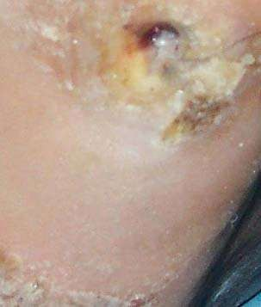
BONE INFECTION

Slide 32
CLINICAL MANIFESTATIONS
SYSTEMIC-
fever, night sweats, chills,restlessness, nausea and malaise
LOCAL-
constant bone pain, swelling tenderness and warmth at the site of infection, drainage from site and restricted movement of affected part

Slide 33
DIAGNOSIS
History and physical examination
X-ray- Irregular decalcification, bone necrosis are evident
Biopsy, wound culture- to determine the microorganism
Blood investigation- WBC, ESR,blood culture
MRI,CT,radionuclide Bone scan - TO detect the extent of infection

Slide 34
MANAGEMENT
Goal- control and halt the infection process
immobilize the body part to prevent pathological fractures
Warm wet soaks for 20 minutes several times a day may be prescribed to increase circulation

Slide 35
Reference
Harsh Mohan Text Book of Pathology
Robbins & Cotran Pathologic Basis of Disease

